Slide 1
Microcontroller perimeter guard control device
Notes:
Dear Head!
Dear Members of the Examination Commission (EC)!
Your attention is given to the certification of the bachelor's degree on the topic: (----).
(Read the slide)

Slide 2
The purpose and objectives of the project
The purpose of certification work is to develop a microcontroller device for managing the perimeter security based on automaton models.
To achieve this goal, the following tasks need to be done:
Consider the principles of building security systems
Develop an algorithm for managing a security system based on automaton models and event handling principles.
Choose the technology platform for implementation of the control device.
Run the programming of the microcontroller control unit.
Run simulation of the developed device.
Notes:
In the modern world, without certain security and control measures, it is simply impossible to do. The reality is that in modern society two directions of activity are developing simultaneously: how to steal and how to save information and property.
Any house has an adjoining territory that is limited by the perimeter. The task of any technical security system - as soon as possible to detect an invasion of the protected object, and to inform the defense as soon as possible and efficiently. This is possible only with the integrated approach with the use of several types of security systems. There are many options for equipping the perimeter of the site with a variety of security systems.
Despite the fact that each perimeter security system design is unique, the management systems of these systems have common construction principles. Thus, the task of constructing a microcontroller perimeter security management system based on automaton models is relevant.
Next on the slide

Slide 3
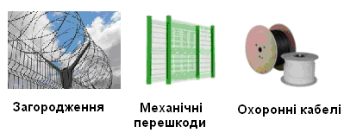
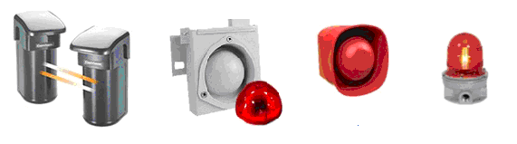
Technical facilities of perimeter security
Physical protection systems perimeter
Electronic perimeter security systems
Notes:
Technical means of perimeter security systems are divided into systems of physical (mechanical) protection and systems of technical (electronic) protection.
A mechanical system is a barrier or obstacle that complicates and retards the offender's actions. For the protection of the perimeter use fences, flat barriers, barbed wire and other fences. The optimal combination of mechanical products and signaling provides the security system with a time to detect and decide on the signal transmission of the intruder.
The systems of technical protection are divided into detectors ("informers") and detectors ("the promoters").
Technical means of perimeter security are a complex of engineering tools for early detection and protection of the territory from the penetration of unwanted persons. Perimeter security sensors can detect an attacker before it penetrates into the protected object.
These are photovoltaic and volume sensors, sound and light alert systems.

Slide 4
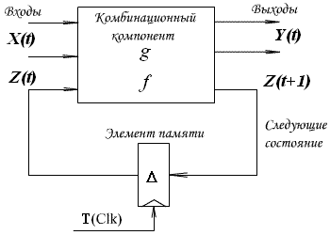




Control Device model of the structural unit
Output function Transition function Change of states Expanded f
Structural Automaton Model (Huffman Model)
The structural automatic machine operates at automatic time, which is measured in steps {t, t + 1, t + 2 ...}, that is, the automatic machine moves from one state to another in one automatic timing cycle.
The duration of the automatic tact can thus be the same for all states of the machine and depends only on the frequency of the synchronous sequence of Clk, but may be different for each state and have a T duration.
The duration of the automaton of the Moore automaton is determined for each state separately.
The automaton transitions graph, which takes into account the duration of the automaton tact for each state of the automaton, will be called the temporal graph of transitions, which is described by the expanded function of transitions.
Notes:
As a control device, a structural automaton, represented by the Huffman model, was used. The peculiarity of this automatic machine is the different length of the automatic tact, which is due to the different lengths of traffic lights cycles.
Read from the slide

Slide 5
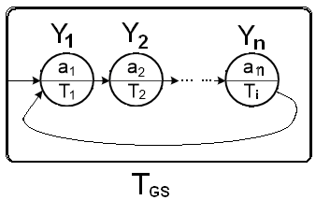


Hyperstate in the model of a structural automaton
Output function Transition function Functions of junctions outputs of the hyperstate
Principles of constructing a hyperstate
Hyperautomat is a machine with hyperstate in its composition.
Hyperstate - a set of states of an automaton, the transitions between which are carried out unconditionally, taking into account only the time of existence of each of the states. The states of the machine, which are part of the hyperstate, are fully or partially looped.
The entrance to the hyperstate always occurs to the first state of the set of states of the hyperstate, regardless of which of the states of the main automaton is the transition to the hyperstate.
The exit from the hyperstate occurs either after the time of the existence of the hyperstate, or in the presence of an "external" event (which is formed outside the set of output signaling signals of the automaton), regardless of which of the states of the hypersurface is an automatic machine at this time.
Notes:
Read from the slide
Hyperstate (its implementation in the program code) is a structure inverse to the design process (process) in the languages of the description of the apparatus. The process calculates the values of signals and variables, regardless of the time parameter. In the opacity of the opacity, the conversion function is calculated solely from the time parameter. The states of the automaton, which are part of the hyperstate, are represented by the Moore model without input signals (except for time).
Hyperstate does not have separate output variables, only the original variables of the main machine are used. The output variables of the main machine can be used in the hyperstate and vice versa.In the quirks, the alarms of the main machine may change, but the output from the hyperstable is either by the time parameter or by an external event.

Slide 6
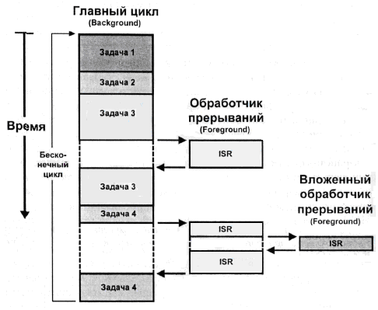
Events in automatic control systems
Input signals of a structural automaton are divided into two types: values and events. Values correspond to the input variables of the automaton and are, as a rule, throughout the automaton timing and can affect the output signals of the automaton. Events (events, events) may have a duration shorter than an automatic tact and directly affect the state of the machine.
In the event-based programming, there are five elements:
- the source of the event;
- event signal;
- event listener and dispatcher;
- event handler;
- object of the event.
Processing events in the microcontroller unit
Notes:
Input signals of control devices by organizing interrupts. Are divided into input actions (inputs) and events (events). Incoming actions are implemented by polling at a time determined by the control algorithm. An event in microcontroller systems is such a change in external signals (conditions), which requires an instant reaction that will cause the corresponding change in the state of the control automaton.
In microcontroller devices, the processing of events is carried out by organizing a multilevel interrupt system.

Slide 7
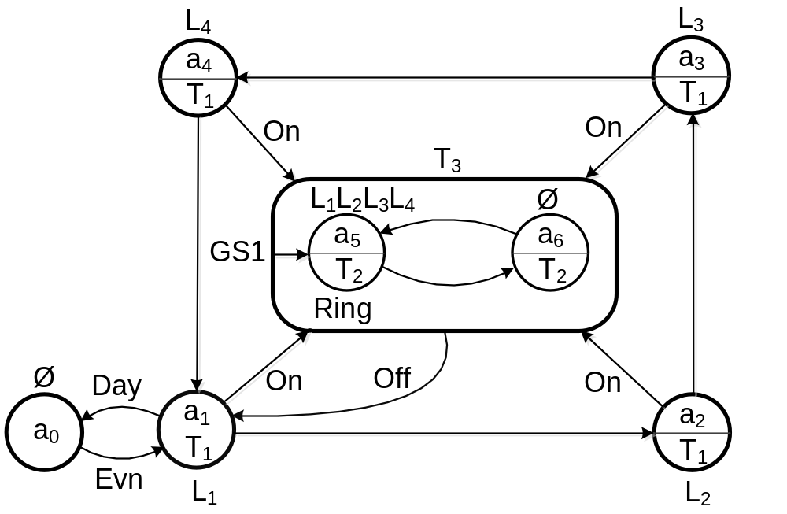
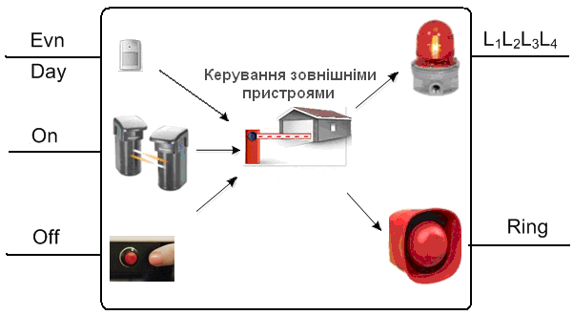
Automatic model of control device
Control device interface
Control device transition temporal graph
The set of input signals is X = {Evn / Day, On, Off}, where Evn / Day = {0, 1} is the signal of switching on / off the perimeter security system depending on the daylight mode, On = {0, 1} event) about an attempt to disturb the perimeter, Off = {0, 1} - signal (event) to exclude the emergency mode of the security system.
The set of output signals Y = {Li, Ring}, where Li = {L1, L2, L3, L4} is the set of signals of the inclusion of light detectors on the attempt of unauthorized crossing of the guarded perimeter, Ring - the signal of the inclusion of sound detectors about the attempt of unauthorized perimeter crossings, guarded.
Notes:
The inclusion of a perimeter security system, for example, a private home or a warehouse, is carried out after the end of the day (a photovoltaic sensor produces a signal Evn = 1). The exclusion of the system is carried out at the onset of a light day ((Day = 1). In an unauthorized attempt to cross the perimeter, the opto-electronic detector produces a signal (event) On = 1. The control unit accepts this signal and includes light and sound alarms (signal lights and The siren mode is used) The mode is implemented by using the GS1 oscilloscope's gistare.This mode continues until the alert guard does not turn off alarm alarms by pressing the corresponding button (Off = 1) to the security mode.
To implement the control machine, we will select Moore's automaton, because the output of the control device depends only on the states of the automaton, and its duration is determined by the internal delay of a certain state of the automaton.
The slide shows the interface of the control unit and its conversion graph
Read from the slide

Slide 8
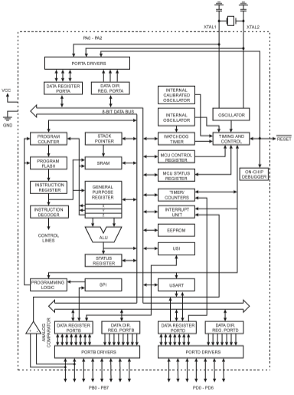
ATtiny2313A
ATtiny2313A
Block diagram
Notes:
AVR (Advanced Virtual RISC) Microcontrollers is one of the most interesting areas that are developed by Atmel {USA}. They represent a powerful tool for creating modern high performance and economical multi-purpose microcontrollers. Currently, the price-performance-power consumption ratio for AVR and one of the best in the world market for 8-bit microcontrollers. A big advantage is also the fact that there is an increasing number of third-party firms that develop and release a variety of software and hardware support development for them. It can be assumed that AVR is becoming one of the industry standard among 8-bit general-purpose microcontrollers.
ATtiny2313A / 4313 - 8-бітний мікроконтролер CMOS з низьким рівнем потужності, що базується на архітектурі RISC AVR. Виконуючи команди в одному тактовому циклі, ATtiny2313A / 4313 досягає пропускної здатності, що наближається до 1 MIPS на МГц, що дозволяє конструктору системи оптимізувати споживання енергії та швидкість обробки.
The AVR core combines a rich set of instructions with 32 generic working registers. All 32 registers are directly connected to the arithmetic logic block (ALU), which allows access to two independent registers using one single instruction executed in one cycle. The resulting architecture is more efficient for the code when reaching the bandwidth ten times faster than conventional CISC microcontrollers.

Slide 9
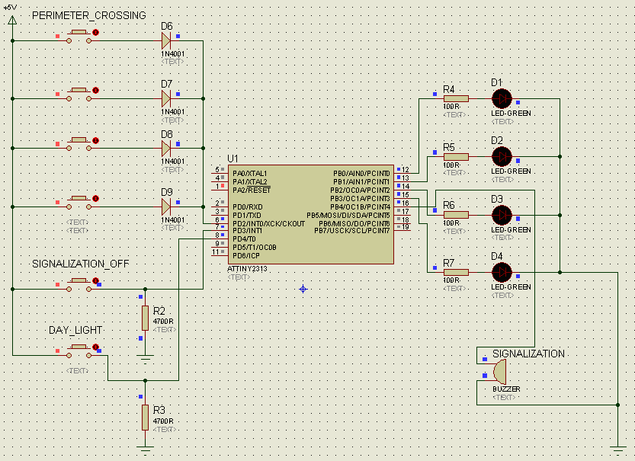
ATtiny2313A connection scheme
Perimeter guard scheme based on ATtiny2313A
Notes:
For the development and simulation of the electric circuit diagram of the pedestrian control unit, we will use the system of automated design of electronic devices (CAD) Proteus
Created in the Proteus software, the circuit diagram of the electronic device is shown on the slide. If all the elements used in the circuit have models that describe their work, then the simulation of the entire scheme can be carried out.

Slide 10
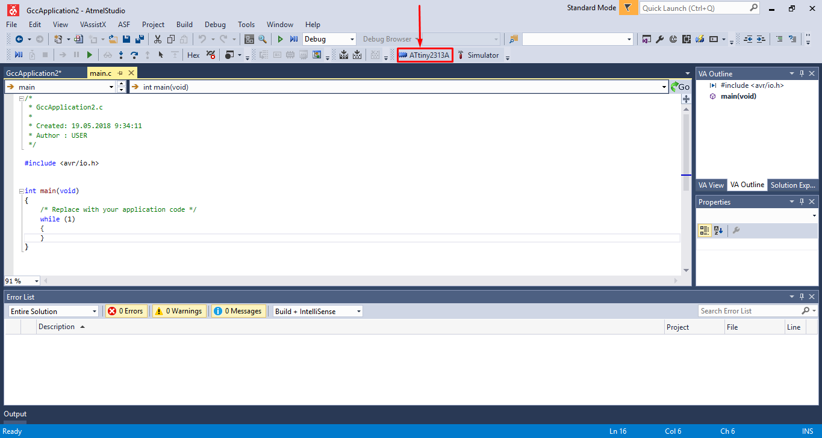
Atmel Studio IDE
Atmel Studio 7 – Free IDE from Atmel company
Notes:
The firmware (programming) for the ATtiny2313A microcontroller is implemented using the program in the programming language C in the Atmel Studio environment.
The environment is designed to develop and debug applications in the C / C ++ language and assembler language for the Atmel AVR 8 and 32-bit microcontrollers, the Wireless SoC Atmel SAMR21, as well as SAM3, SAM4, SAMD, SAMG, and other ARM Cortex core processor cores - M.
It should be noted that there is a possibility to change the microcontroller directly in the already created project. This allows, without changing the source code, to choose another similar microcontroller, on the basis of which, the project will be deployed (highlighted in the figure with a red arrow with a pointer).

Slide 11
Program code for functions and outputs
Fragment of the transition function
case FIRST_ON:
// Need to check one more time
// if the system has stable signal from sensor
if(PIND&(1<<PIND4))
{ PORTB = 0b00000001; // Set appropriate checking LED
nextState = SECOND_ON; }
else { nextState = START;}
break;
A fragment of the output function for the hyperstate
// Hyperstate
case RING_ON:
PORTB = 0b00011111; //Enable all LED's and singalization
nextState = RING_OFF;
break;
case RING_OFF:
nextState = RING_ON;
break;
Notes:
The program has implemented the principle of "automaton programming". At the implementation stage, a program (in the appropriate programming language or hardware description) is constructed, in which the conversion graphs, input variables, event handlers and output actions are implemented in the form of appropriate language constructs.
Each graph of transitions is formally and isomorphically implemented by a separate function (subroutine), created by a template that contains two constructs of the switch and the if statement. The first design of the switch implements the overheating function, and the second construction of the switch activates the output function.
This design is called "automaton pattern"

Slide 12
Program code of the training system for the protection of the work
A fragment of the timer's initialization function
void TimerInit(void)
{
TIMSK = 0b01000000; // Allow Timer1 interrupt compared with OCR1A (H and L - High bits and Low bits)
// Set value to compare for interrupt (31250)
OCR1AH = 0b01111010;
OCR1AL = 0b00010010;
TCCR1B = T1; // Set prescaler
}
// Timer1 overflow interrupt handler
ISR (TIMER1_COMPA_vect)
{
sei(); // Allow all interrupts
StateTransition(); // Start FSM
}
A fragment of the system's preparation function to work
ISR(INT0_vect)
{ // Need to check if it's evening
if(PIND&(1<<PIND4))
{
GIMSK = 0b10000000; // Off signalization handler
state = RING_ON; // Hyperstate entry
TCCR1B = T2; // Set new prescaler
}
Notes:
To implement the delays of each wall in the temporal conversion column, the timer function is used. To do this, use an internal timer microcontroller, the fragment of the initialization function is shown on the slide 10.

Slide 13
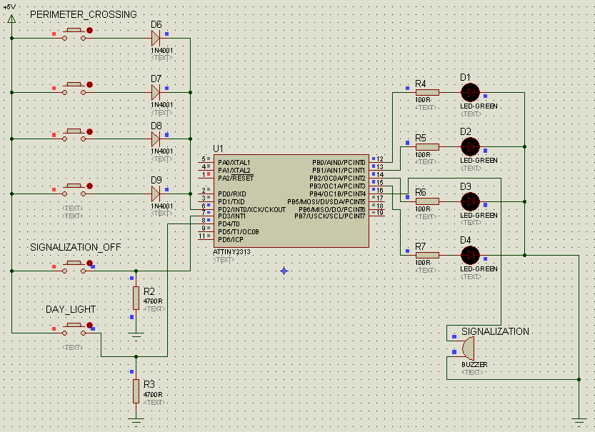
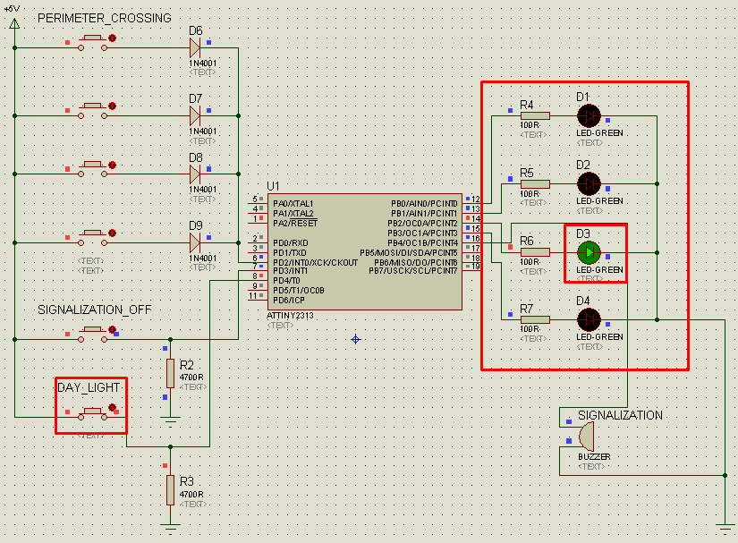
Modeling the perimeter guard control device
The start of the device, the state "START" (a), and the normal operating system «FIRST_ON» – «SECOND_ON» – «THIRD_ON» – «FORTH_ON» (б)
Notes:
Directly the beginning of the system occurs when the dark part of the day arrives. A signal is sent to the corresponding sensor (in this case, pressing the "DAY_LIGHT" button). This translates from the state of "START" to the state "FIRST_ON" of the machine template and, accordingly, initiates a further cycle of the system in the normal mode.

Slide 14
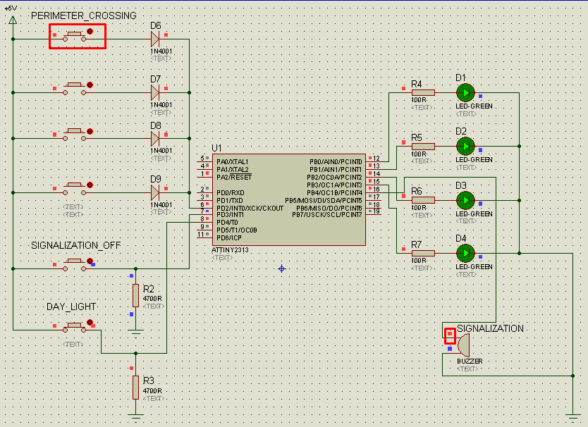
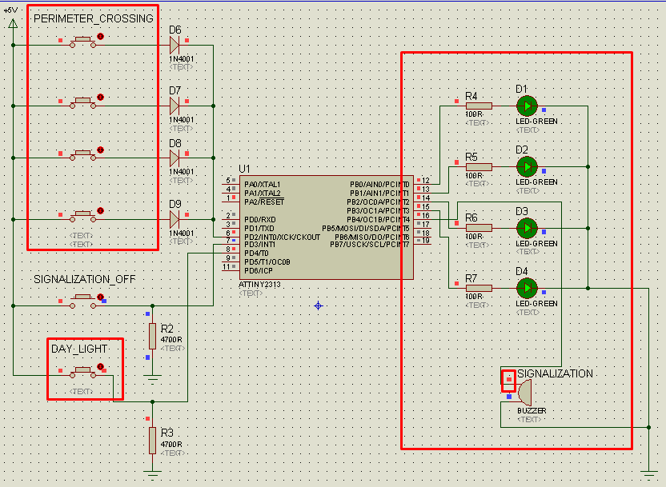
Modeling the perimeter guard control device
"Perimeter crossing" (ISR (INT0_vect)) "RING_ON" - "RING_OFF" for one (a) or multiple sensors (b)
Notes:
When the perimeter cross-section sensor is triggered (simulation of sensor data is represented by closing buttons that supply voltage to the diodes), an event that is processed by a microcontroller ("Perimeter crossing") occurs. This includes the buzzer and all the LEDs simulating the work of the perimeter security system. It should be noted that while simultaneously crossing one, two, three, and four perimeter control sensors at the same time - the system does not fail at work and faithfully handles the event "Perimeter crossing"

Slide 15
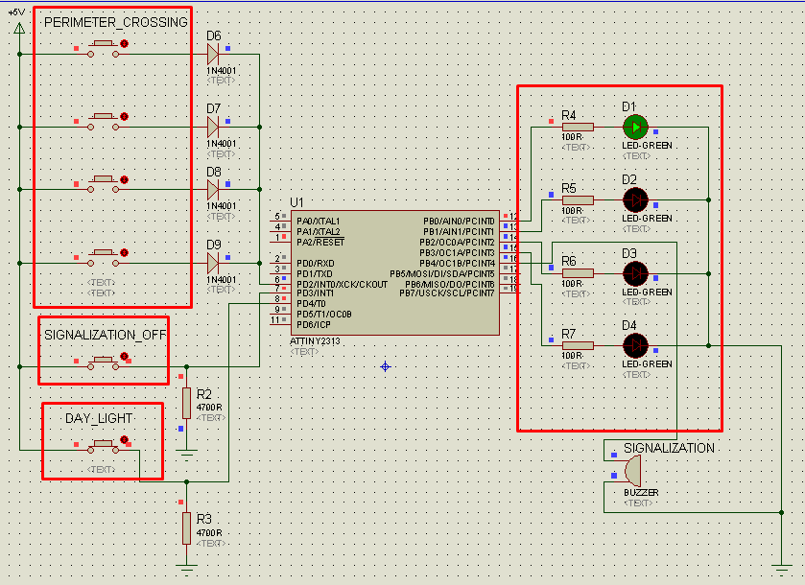
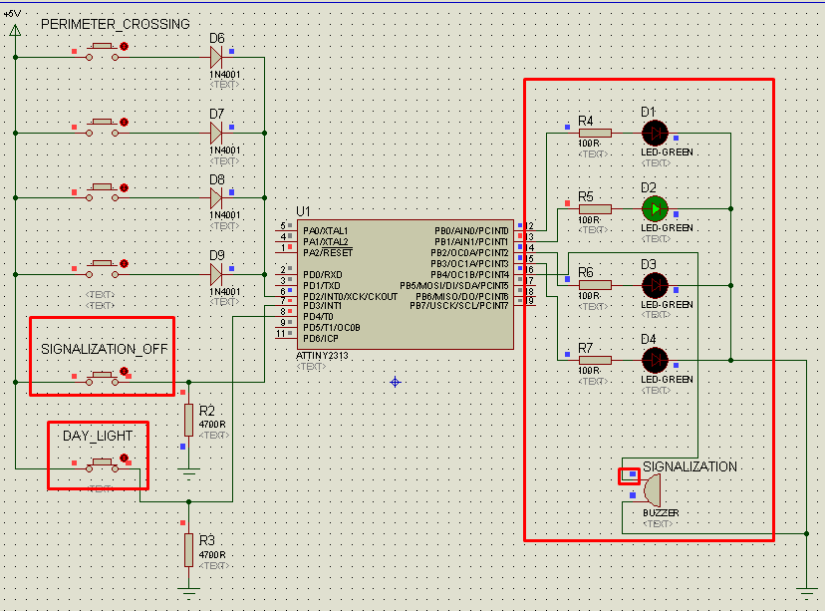
Modeling the perimeter guard control device
Disconnection of the signaling and the transition of the system to the normal operating mode (a) and the blocking of the disconnection of the signaling (b)
Notes:
Processing of the event of switching off the signaling "Signalization off" translates the system into the initial state "START", which restores the normal mode of operation of the system. The alarm will not be included in the daytime (switching off the light sensor during daylight hours), and the alarm will only work when you cross the perimeter. Disabling the alarm in the absence of crossing the perimeter is impossible.

Slide 16
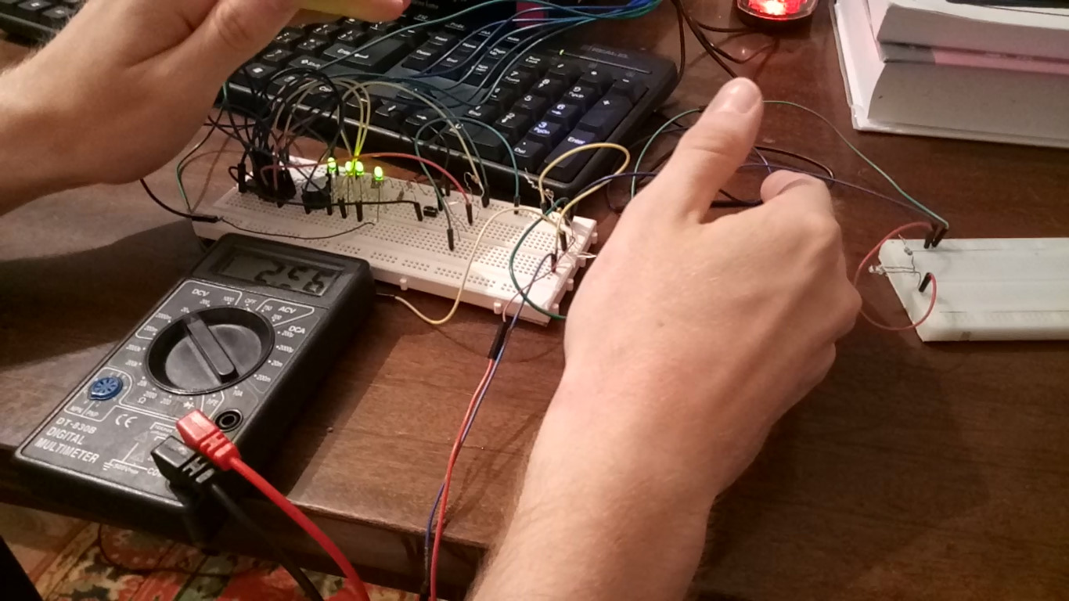
Simulating the perimeter guard control device
Simulation of perimeter violation mode
Notes:
For the layout of the sound siren, the sound generator HCM1205X is used. The audio frequency is 2.3 kHz, with a power of 85 dB. As an IR transmitter, the BIR-BM1331 LED is used, and the BPT-BP2931 photoconductor is an infrared receiver.
The slide shows the simulation of the work of the developed device and the mode of violation (unauthorized cross section) of the guarded perimeter. Sharp voltage drop (about 2.5 volts) with stabilization informs the system of violations and the system goes into standby manual shutdown mode
And now the video

Slide 17
Conclusions
During the performance of certification work, a microcontroller device for managing the perimeter security system was developed on the basis of a finite automaton.
When constructing a mathematical model of the control device, the superstructure was applied over the standard model of the finite automaton, namely, the hyperautomat, in which the transition between the states depends solely on the time parameter in the corresponding automatic state. The control device model is represented as a temporal conversion column
The controller is implemented on the basis of the AVR microcontroller (ATtiny2313A). The software implementation of the control algorithm is carried out in the programming language C in the development environment of Atmel Studio 7.
The simulation of the developed control device was carried out by the instrumental CAD tools of Proteus. For the layout of the sound siren, the sound generator HCM1205X is used. The frequency of the audio signal is 2.3 kHz, with a power of 85 dB. As infrared transmitter used LED BIR-BM1331, and as an IR receiver, the photo-resistor BPT-BP2931.

